Slide 1
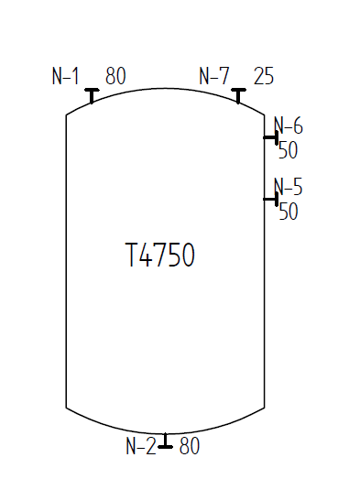
Test Case E02V02 – Tank with Nozzles
Tank with tag name T4750
5 nozzles:
sub tag name (graphics + engineering information)
nominal diameter (graphics only)

